Slide 1
Ensuring Older Persons’ Rights to Long-term care through social protection floors
Xenia Scheil-Adlung
Global health and long-term care advisor
Former Health Policy Coordinator, ILO Geneva

Slide 2
Overview
Legal foundations of rights to care for older persons
What are the deficits in LTC coverage and access?
Addressing the deficits
AGE Annual Conference 2018, 6 June Brussels, Belgium

Slide 3
What are the legal foundations of rights to LTC for older persons?
Human Rights
International legal instruments
National legislation
Human Rights to Social Security
ILO Conventions and Recommendations
Human Rights to Health
International Covenant on ESCR
UN Convention on all forms of Discrimination against women / Races / Rights of persons with disabilities
Other international conventions and instruments
R 202 on national social protection floors
Legislation on social security guarantees to benefits in kind and in cash to access
Health
Long-term care
AGE Annual Conference 2018, 6 June Brussels, Belgium

Slide 4
National social protection floors for older persons (R 202): What needs to be reflected in national legislation?
Universality: Access for all ages
Equity: Equitable access for all ages
Solidarity: Financing across generations
Services for older persons: Criteria to be met
Affordability of services for all ages
Availably of services for all ages
Financial protection for all ages
Legal guarantees to access nationally defined services
(e.g. health and long-term care)
Access to services: Key principles
Quality of services acceptable for all ages
AGE Annual Conference 2018, 6 June Brussels, Belgium

Slide 5
Legal foundations of rights to care for older persons
What are the deficits in LTC coverage and access?
Addressing the deficits
AGE Annual Conference 2018, 6 June Brussels, Belgium

Slide 6
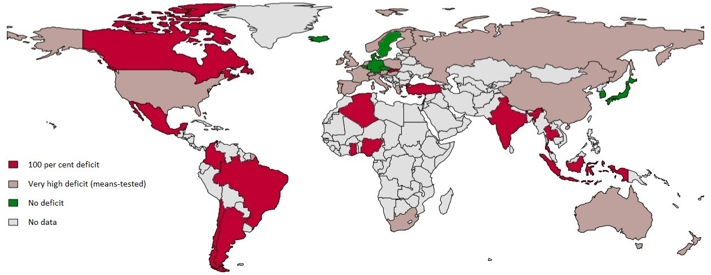
Global deficits in rights of older persons to LTC
Global deficits in LTC coverage for older persons aged 65+ in % of total population, 2015
Source: ILO estimates 2015, World Bank, 2015 (population data in 2013)
AGE Annual Conference 2018, 6 June Brussels, Belgium

Slide 7
What is the size of older persons concerned by deficits in rights to LTC ?
Percentage of global population 65+ by LTC coverage deficits
Source: ILO estimates 2015, World Bank, 2015 (population data in 2013)
48% (300 million people) of the global older population lives in countries without rights to LTC
46.3 % of the global population lives in countries with means tests forcing people to become poor before becoming eligible for LTC
5.6% of the global older persons live in countries with rights-based universal LTC coverage
AGE Annual Conference 2018, 6 June Brussels, Belgium

Slide 8
(Un)availability of quality services: Workforce shortages are too important to be compensated by unpaid volunteers or family members…
LTC workforce shortages
*Threshold: 4. 2 per 100 persons aged 65+
Source: ILO estimates, 2015; OECD, 2014
AGE Annual Conference 2018, 6 June Brussels, Belgium

Slide 9
Impact of workforce shortages on older persons access to LTC: LTC access deficits of older persons
Access deficits of older persons due to workforce shortages
By Region, in % of population aged 65 + not covered*
*Threshold: 4.2 LTC workers per 100 persons 65+
Source: ILO estimates, 2015; OECD, 2014
AGE Annual Conference 2018, 6 June Brussels, Belgium

Slide 10
Affordability of quality services
Out-of pocket payments for LTC of older persons
are likely to have an impoverishing potential
Country | Percent of total population with rights in national legislation | Out-of-pocket payments in %of total expenditure
Countries with no rights
Argentina | o | 60-80 %
China | 0 | 100 %
Mexico | 0 | 100 %
Countries with restricted rights
Australia | Means tested / no cash benefit | High: depends on income
South Africa | Means tested | Home based care: 100 % Institutional care: depending on institution
Countries with universal rights
Germany | 100 % | 25 %
Japan | 100 % | 10 % / 100 % above limits
Source: ILO 2015 based on national legislation and regulation
AGE Annual Conference 2018, 6 June Brussels, Belgium

Slide 11
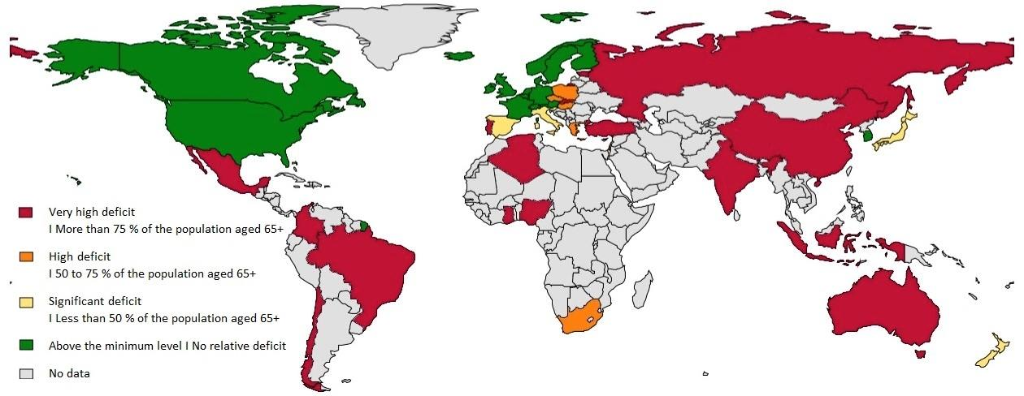
Older persons with rights to LTC: Deficits due to lack of public funding for quality services
Population 65 + excluded due to deficits in public expenditure (threshold in 2015: 1461.8 PPP$ per person aged 65+)
Source: ILO estimates 2015, OECD, 2013; World Bank, 2015 (population data in 2013)
AGE Annual Conference 2018, 6 June Brussels, Belgium

Slide 12
Legal foundations of rights to care for older persons
What are the deficits in LTC coverage and access?
Addressing the deficits
AGE Annual Conference 2018, 6 June Brussels, Belgium

Slide 13
How is LTC covered in Social Protection Floors? Components of Social Protection Floors :
Addressing deficits in the context of National Social Protection Floors (R 202):
Guaranteed rights for older persons in national legislation to access needed
Quality care services
Income support
Universal access to health care services
Basic income security at poverty level for children to access education, health, housing
Basic income security for all in working age;
Social assistance for the poor and unemployed
Basic income security for those in old age securing access to needed services
HEALTH AND LONG-TERM CARE
provided as a range of services and cash benefits
addressing reduced functional physical and/or cognitive capacities of older persons
AGE Annual Conference 2018, 6 June Brussels, Belgium

Slide 14
Addressing deficits: Providing and implementing rights to universal health and LTC protection within national social protection floors (R 202)
Establish LTC as a right in its own
Develop inclusive national LTC legislation for older persons
Implement legislation
Address the socio-economic determinants of deficits
Coordinate LTC, health, social, economic, labour market and developmental policies
Consider living conditions of older persons
Address old age poverty : Raise household income of older persons through social protection income support
Address discrimination and exclusion from participatory processes
Adjust benefits and eligibility rules to ensure effective access
Make quality LTC available: Increasing the number of skilled workers
Guarantee affordability and financial protection by minimizing out-of-pocket payments (OOP)
Set up enabling macro-economic frameworks for sufficient public funding
Develop fiscal space through fair social protection financing mechanisms
AGE Annual Conference 2018, 6 June Brussels, Belgium

Slide 15
Thank you for your attention!
Xenia Scheil-Adlung
Xenia.Scheiladlung@FU-Berlin.de
AGE Annual Conference 2018, 6 June Brussels, Belgium

